Slide 1
Money Management
SUBTITLE :- Efficient strategies for financial growth
Group name :- Budgeteers
Mentor’s Name: Mrs.Sneha Mane
Presented by :-
Vardhman Gadade
2) Jinendra Jain
3) Sujal Bhagwatkar
4) Virag Ajmera

Slide 2

Introduction to Money Management
What is money management?
Managing finances through budgeting , saving , investing & spending
Importance:
-Ensures financial stability and growth
-Helps in making informed financial decisions.
Objectives:
-To provide an overview of effective money management strategies.
-To introduce the concept and benefits of the money management website.

Slide 3
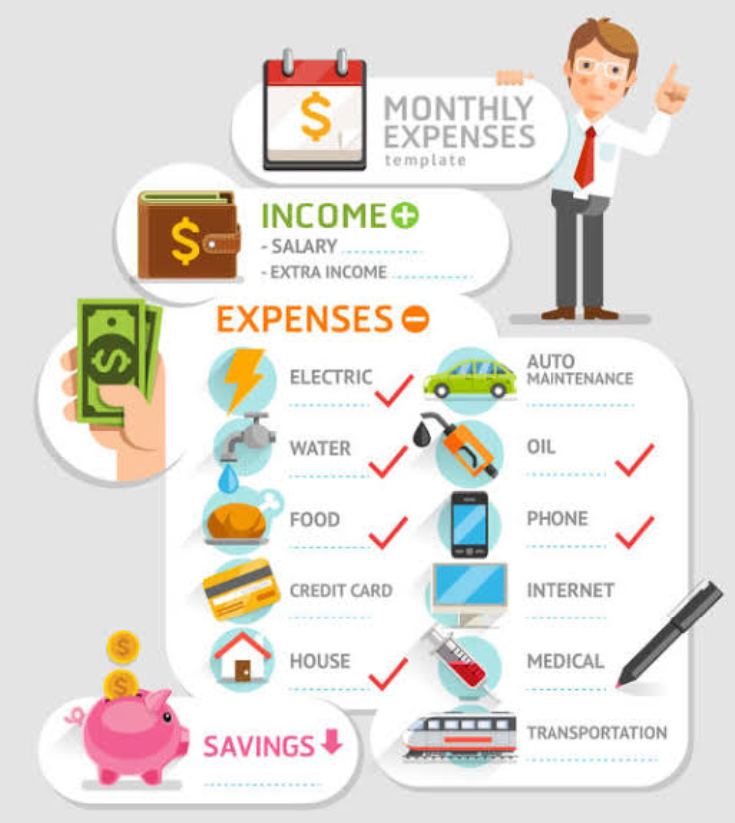
Understanding Expenses
- Expenses can be categorized into fixed (rent, insurance), variable (groceries, entertainment), recurring (utility bills, subscriptions), and non-recurring (one-time purchases).
- Personal expense categories include housing, transportation, food, insurance, entertainment, debt repayment, savings, and miscellaneous.
- Effective expense management involves tracking spending, prioritizing essential expenses, setting financial goals, and regularly reviewing budgets.
- Understanding expenses helps individuals and businesses make informed decisions, achieve financial stability, and reduce unnecessary costs.

Slide 4

Advantages of Money Management
Financial Security:
Reduced financial stress and anxiety.
Improved financial stability and planning
Better Financial Decisions:
informed decisions on spending, saving, and investing.
Enhanced ability to achieve financial goals.
Increased Savings and Investments:
Efficient budgeting leads to more savings.
Opportunities for investments and wealth growth.

Slide 5
Problem Statement and Objectives
Problem Statement:
Many individuals struggle with effectively managing their finances due to a lack of tools for tracking income, expenses, and savings. This project aims to solve this problem by providing a comprehensive *Money Management Platform* that offers budgeting, expense tracking, debt management, and financial goal-setting to promote financial stability and literacy.
Objectives:
Promote financial literacy.
Provide budgeting tools.
Track income and expenses.
Categorize spending.
Manage debt repayment.
Offer financial reports and analytics.
Ensure data security and privacy.
Support user education and assistance.

Slide 6
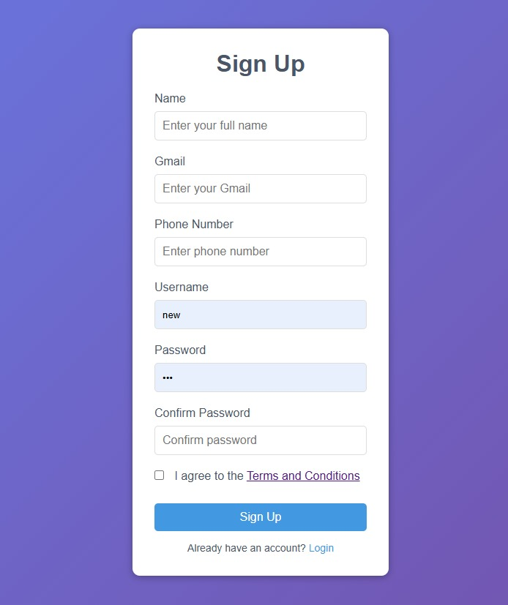
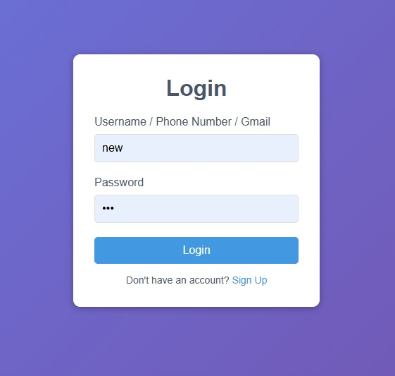
Results/Screenshots
Signup Page
Login Page

Slide 7
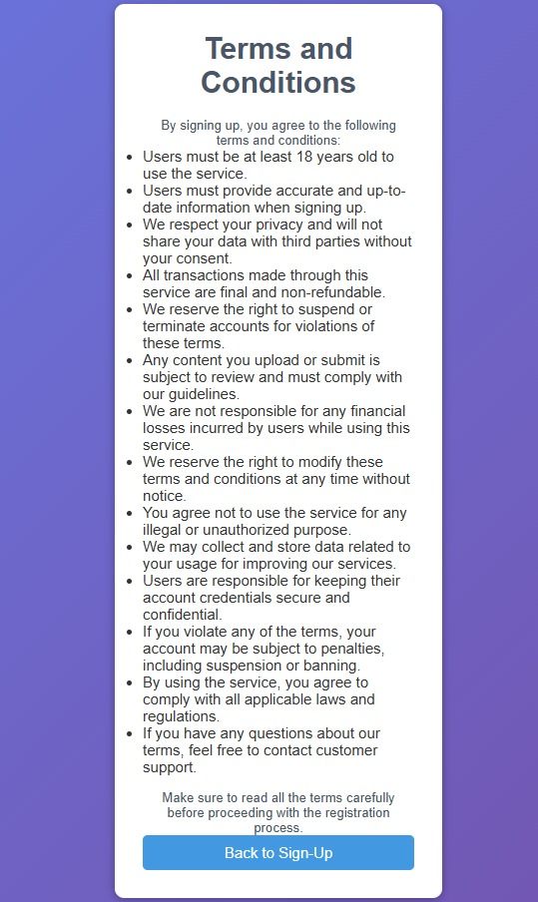
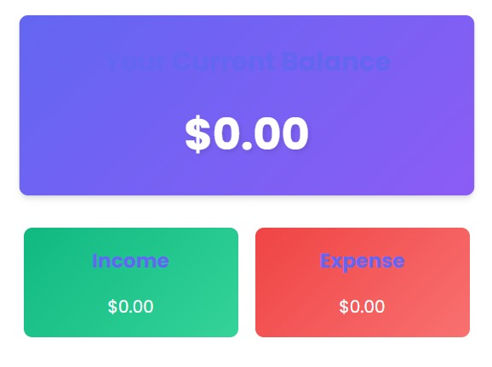
Terms and Condition & Container
Terms and Conditions
Container to store Entries

Slide 8
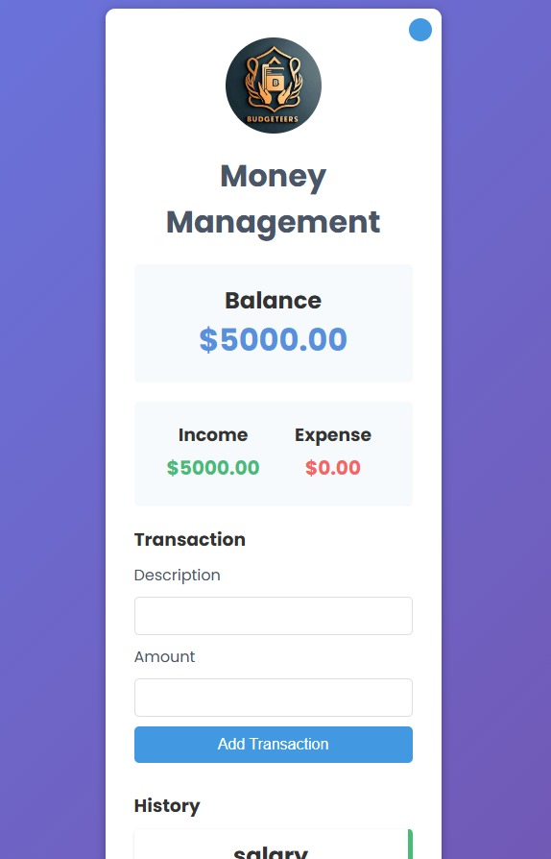
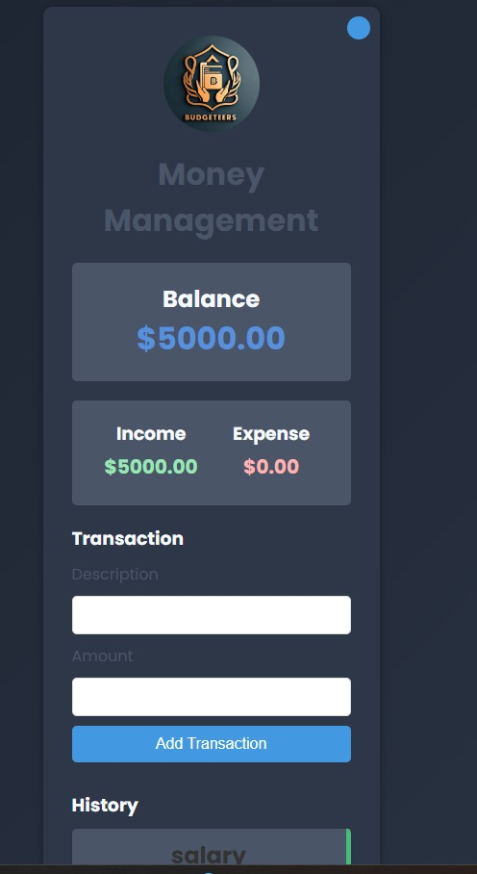
Main Page
Light Theme
Dark Theme

Slide 9

Purpose: * Promote financial literacy among users. * Provide tools and resources for better financial planning. * Help users achieve financial goals and stability. Target Audiences: * Young professionals. * Students. * Families managing household budgets. * Individuals seeking financial independence. * Senior Citizen’s * House wife * Businesses
Why We Created This Website?

Slide 10
TOOLS Used for Website:-
Front-End Development
Languages:
1)HTML5: For structuring the content of web pages
2)CSS3: For styling and layout (responsive design).
3)JavaScript: For adding interactivity and dynamic features.
2. Back-End Development
Languags:
1)Node.js (JavaScript): Lightweight, event-driven back-end runtime.
2)Python (with Flask or Django): Simple and versatile for rapid development.
3)PHP (with Laravel): Commonly used for web development.
Frameworks:
Express.js (for Node.js): Minimal and flexible back-end framework.
Database
Relational Databases:MySQL or PostgreSQL: Widely used, robust relational databases

Slide 11

HOW Website Works?
User Registration & Setup
Simple and quick sign-up process.
Secure user authentication with email/phone verification.
Dashboard Overview:
1.Personalized dashboard displaying key financial metrics:
Total income, expenses, savings, and investments.
Income & Expense Tracking
1)Users can manually input or sync bank accounts to automatically track income and expenses.
2)Categorization of expenses (food, rent, utilities, entertainment, etc.).
Budgeting Tools
Automated budget suggestions based on income and spending patterns.
Users can set custom budgeting limits and track real-time spending.

Slide 12

Savings & Investment Goals 1)Feature to set up specific savings goals (e.g., vacation, emergency fund, etc.). 2)Automated saving plans with recommendations for investment options.
Debt Management:
1)Users input loan and credit card information
2)Displays repayment schedules, interest rates, and remaining balances
Reports & Analytics:
Monthly, weekly, and yearly reports on spending, savings, and investment growth.
Data visualization tools for in-depth analysis.
Visual charts for easy tracking (pie charts, bar graphs, etc.).
Security & Privacy:
Bank-level encryption for data security. Customizable privacy settings, allowing users to control what information is visible.
Regular security updates and compliance with financial data protection regulations.
User Support & Help
In-app tutorials and guides for new users.
24/7 customer support via chat, email, or phone

Slide 13

Advantages of Budgeteers
A Budgeteers website offers automated financial tracking, making it easy to monitor income, expenses, and savings in real-time.
It simplifies budgeting by providing personalized plans and alerts while offering visual insights through charts and graphs.
The platform helps categorize expenses, set and track savings goals, and manage debts with repayment strategies.
With secure data encryption and privacy settings, it ensures safe financial management.
Users benefit from detailed financial reports, improved financial literacy, and the convenience of accessing their finances from any device, anywhere.

Slide 14
Future Scope
To enhance the effectiveness of the money management model, the following future improvements are proposed:
1. Expansion of Features:
Introduce web tool for financial planning tools for personalized budgeting and investment advice.
2. Collaborations :
Partner with banks and financial institutions for seamless transactions and financial products
3. Real-Time Alerts:
Notifying users about overspending or upcoming bills, helping to maintain control finances.
4. Educational Tools:
Offering daily financial tips, improving financial literacy for better decision-making.

Slide 15
Conclusion
Recap of Benefits of Effective Money Management
Empowers individuals to take control of their finances.
Enhances financial literacy and stability across various demographics.
Encourages smarter budgeting, saving, and investing habits.
Promotes long-term financial security and independence.
How the Website Assists in Achieving Financial Goals
Offers tools for real-time expense tracking and budgeting.
Provides personalized financial advice tailored to users’ needs.
Delivers educational resources to improve financial decision-making.
Facilitates better planning for both short-term and long-term goals.
Final Thoughts
Managing money wisely is essential for achieving a secure and independent future.
By leveraging the tools and resources available on this platform, users can confidently make informed decisions to grow and protect their finances.
Take the first step today—embrace smarter money management and pave the way to a more stable and prosperous financial future.

Slide 16
References
Mint – Budgeting and financial planning tool: https://www.mint.com
Investopedia – Financial education and investment resources: https://www.investopedia.com/
NerdWallet – Financial advice and tools: https://www.nerdwallet.com
Dave Ramsey – Personal finance and budgeting resources: https://www.daveramsey.com
“Fake News Detection on Social Media: A Data Mining Perspective,” IEEE
Transactions on Knowledge and Data Engineering (Relevant research paper)

Slide 17

Thanks!
Team :- Budgeteers
budgeteers2409@gmail.com

